Slide 1
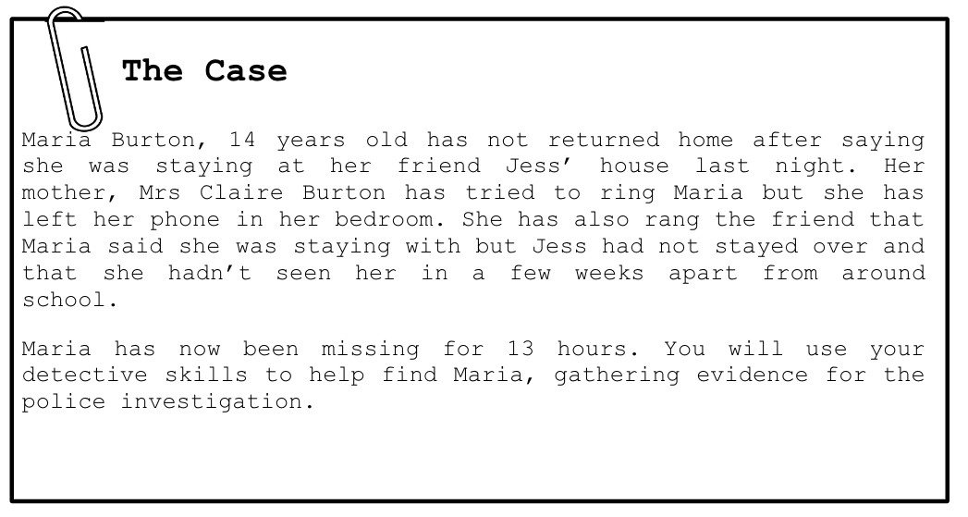
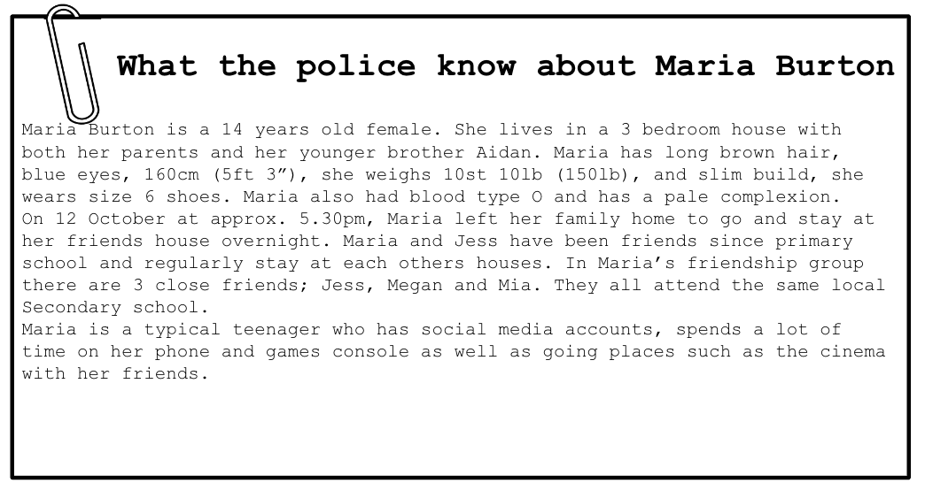
Day of missing report Oct 13
Missing person Maria Female 14 years of age
She left her home supposedly to go to her friend Jess’s house at 5:30pm on Oct 12
Jess says she never showed up or discussed this with Maria once her mother was informed of this she filed a missing person report to the police the next day
Police investigated this for days on end they checked her social media and they found that one of her photos was taken on a different phone a Samsung Galaxy Maria owns an iphone this suggested someone has logged into her account because maria also left her phone at home later police checked her messages and someone called ashley who was unknown at the time had been texting her a few days before she went missing.Police used this info to track this guy down and they were successful he was a 17 year old man who was grooming and talking to Maria on social media in attempts to gain her trust.They found maria in tears locked in a bedroom on the second floor.
Opening Paragraph:
Describe what happened to the victim. Give the date and time that she went missing, along with when and where she was found.

Slide 2
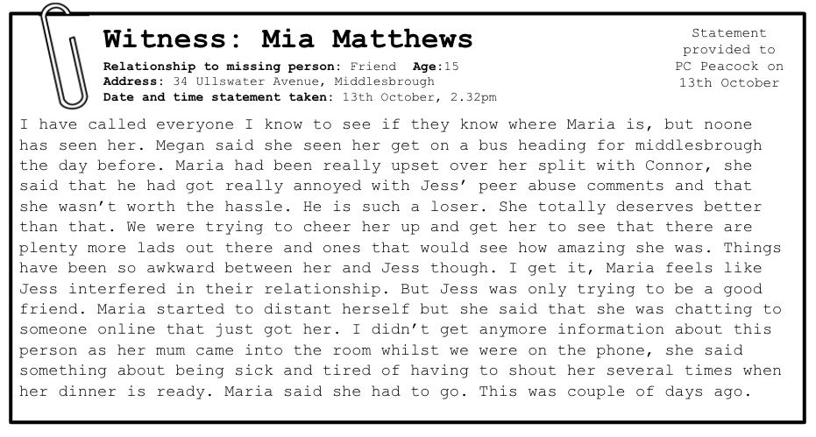
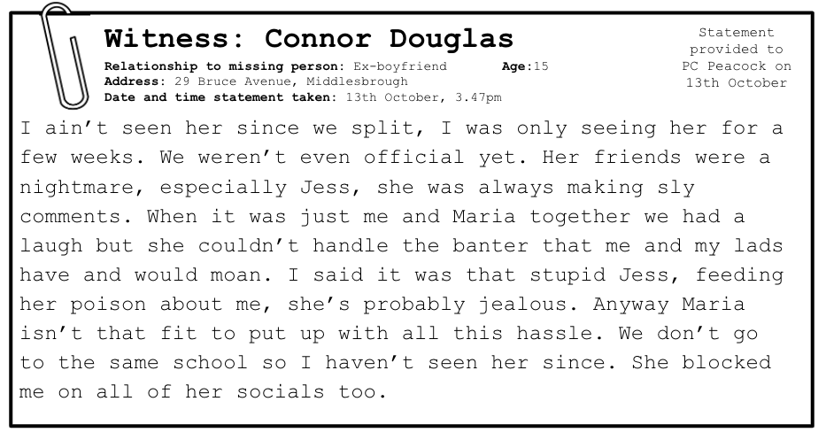
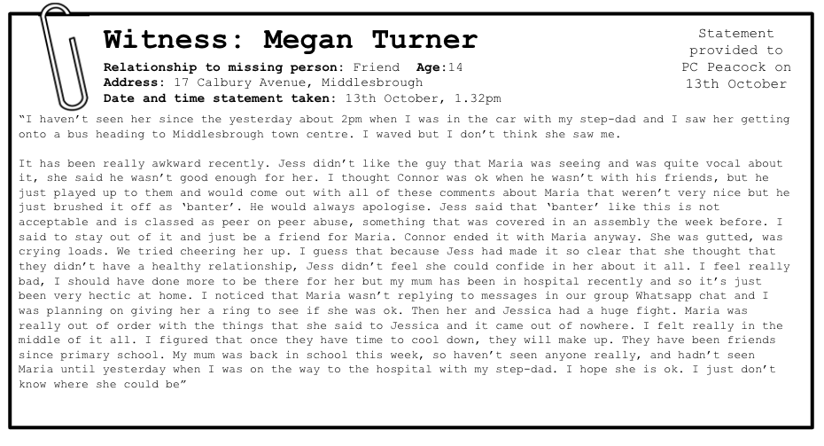
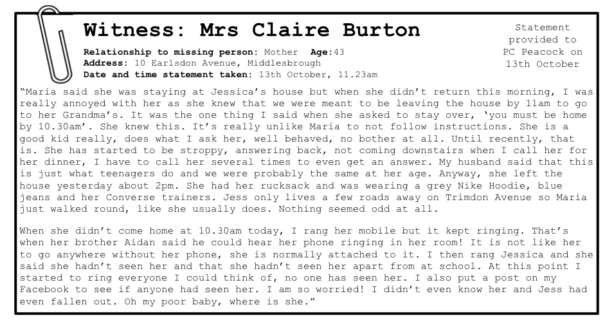
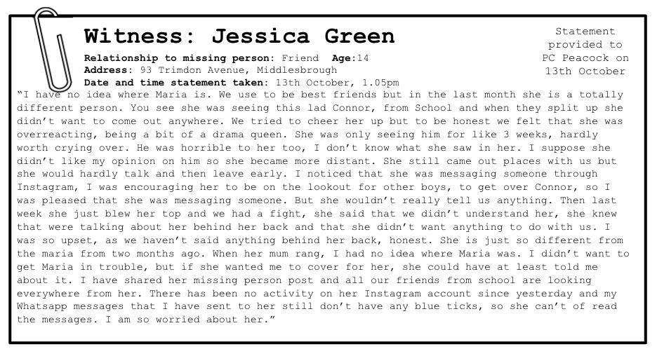
Witness Mia Matthews
She stated that she had called everyone she knows to trie located Maria or get something about her whereabouts.She also mentions how she was really annoyed and upset about her split up with her ex Connor.
Witness Megan Turner
She stated that thing between Jess and Maria had been really awkward recently because Jess didn't like the guy Maria was dating at the time (Connor)
2nd Paragraph:
Give details on the witness statements that helped the case. Did any of the witness statements give you any clues as to Maria’s Location.

Slide 3

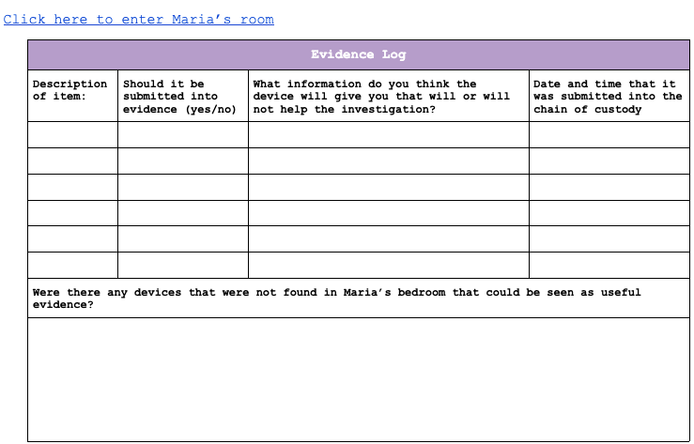
Replace with your own evidence log
Third Paragraph:
Describe what devices were added into evidence from the search of Maria’s room. Explain why these devices are important to the investigation (what data might they have on them that will help find Maria)
Explain what chain of custody means.
Add a screenshot of your evidence log to this page (you can put it over the top of the blank one to the right)

Slide 4
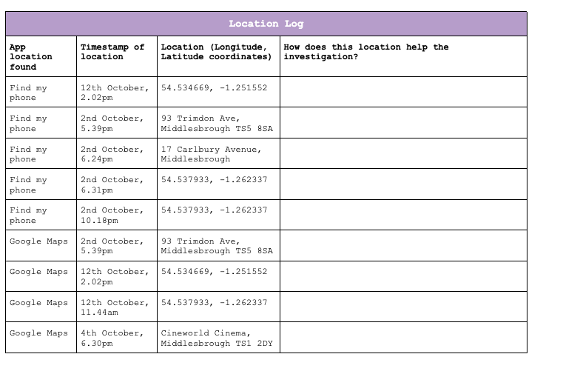
Screenshot of your Google map to go here
Replace with your own location log
Fourth Paragraph:
Explain how the locations found on the Maria’s devices helped the investigation.
Which locations helped the investigation?
Insert a screenshot of your Google Map that plotted all of the locations.

Slide 5
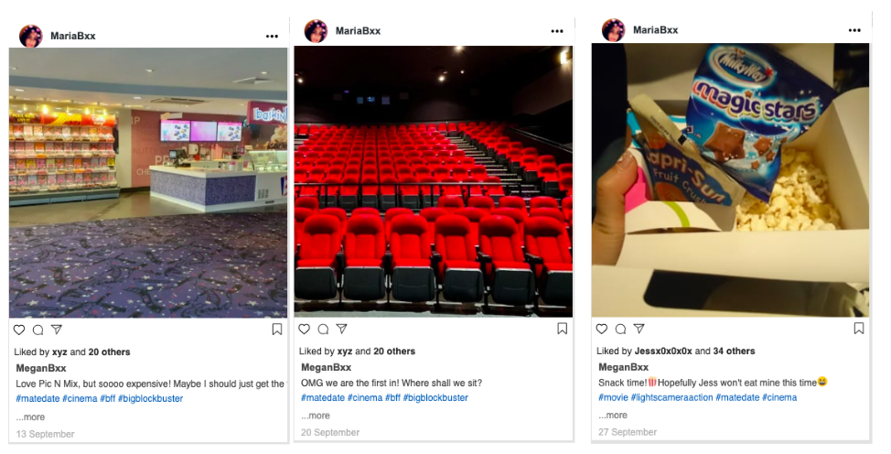
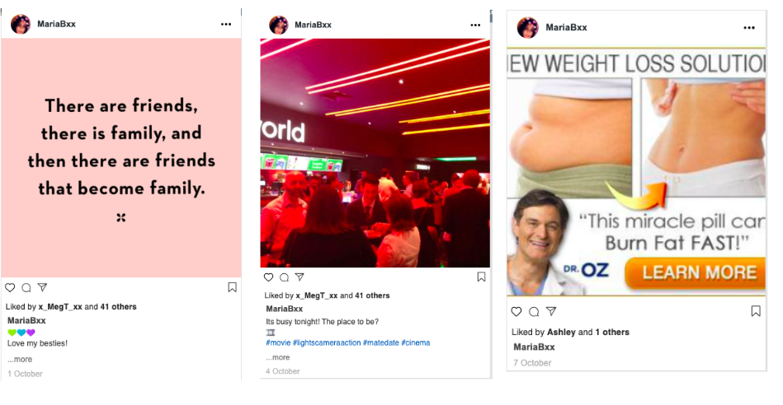
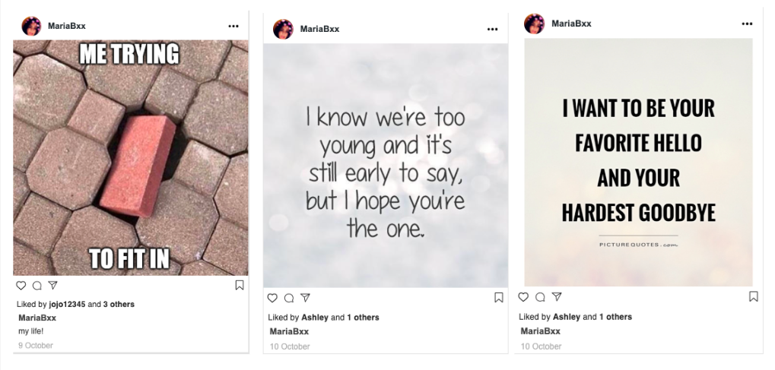
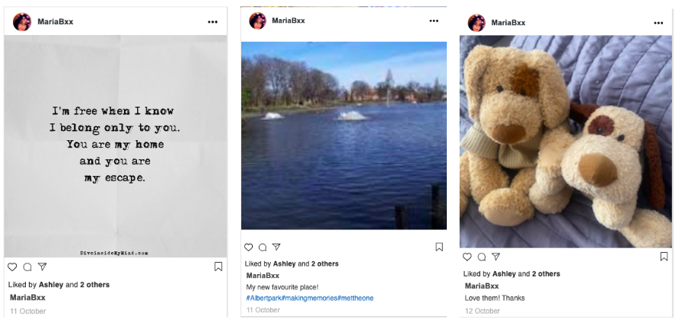
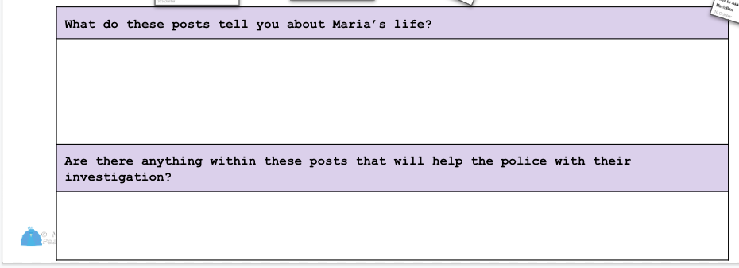
Fifth Paragraph:
Explain how the Instagram posts leading up to Maria’s disappearance helped the investigation. What did the posts tell you about Maria’s life?

Slide 6
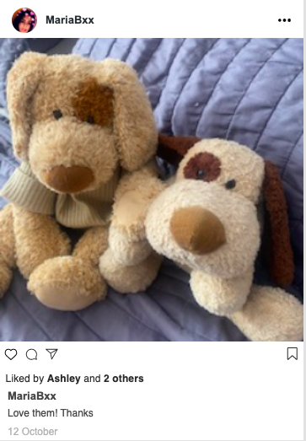
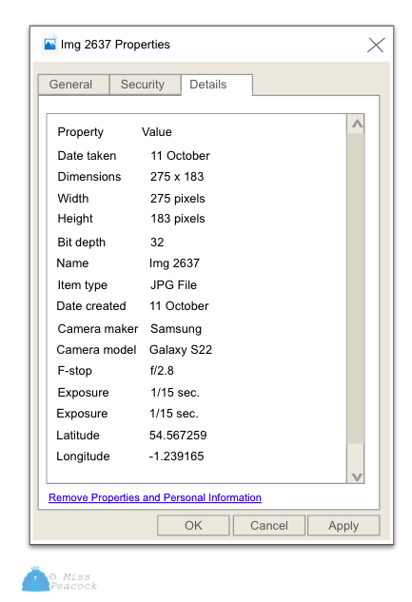
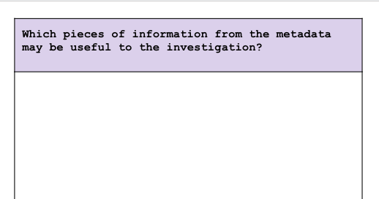
Sixth Paragraph:
Describe what metadata is and how there was metadata on the image from the Instagram post about teddies.
Which piece of information from the metadata was useful to the investigation?
What did these piece of metadata tell you?
Replace with your own (metadata lesson)

Slide 7
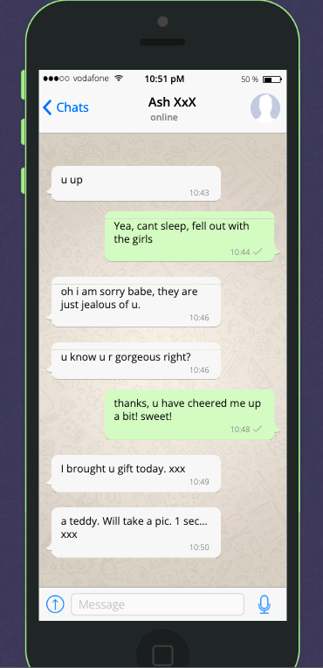
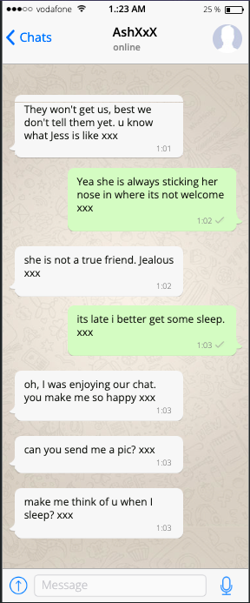
Seventh Paragraph:
Describe the content of the messages from AshXxX to Maria’s which were found on Maria’s phone.
What can you infer from these messages? Was this a healthy relationship?

Slide 8
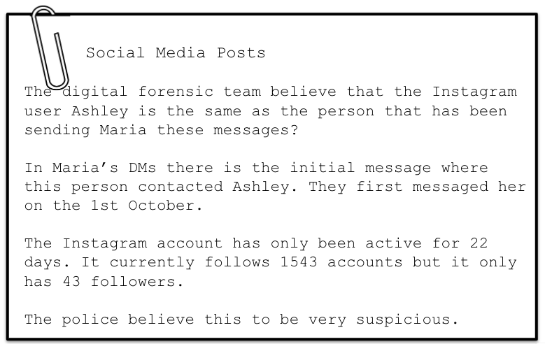
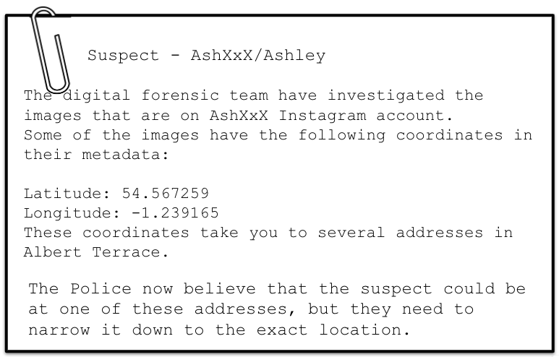
Eighth Paragraph:
Why is the number of followers and how long the account has been active, something that is concerning and very suspicious?

Slide 9
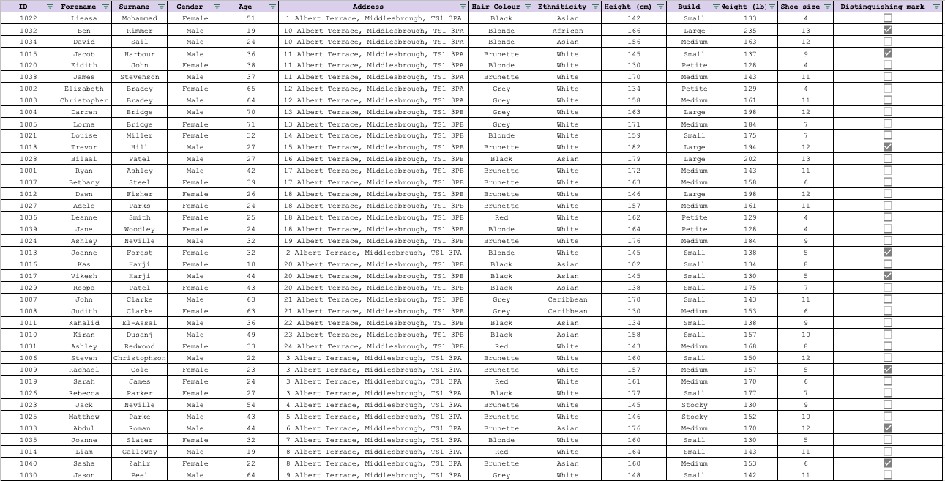
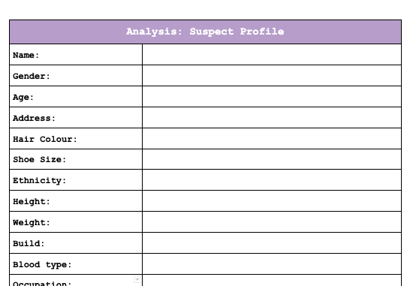
Replace with your own suspect profile
Ninth Paragraph:
Describe how you searched the Police central record
What information were you able to find from this?

Slide 10
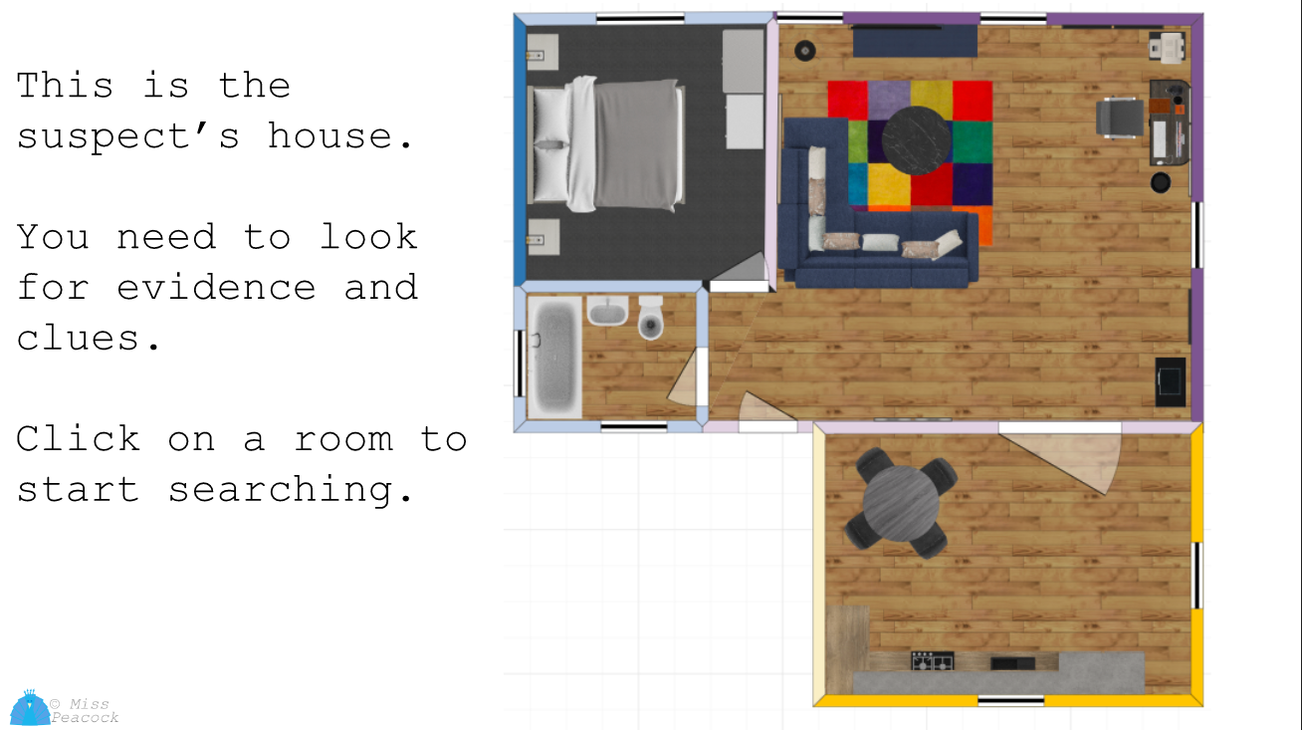
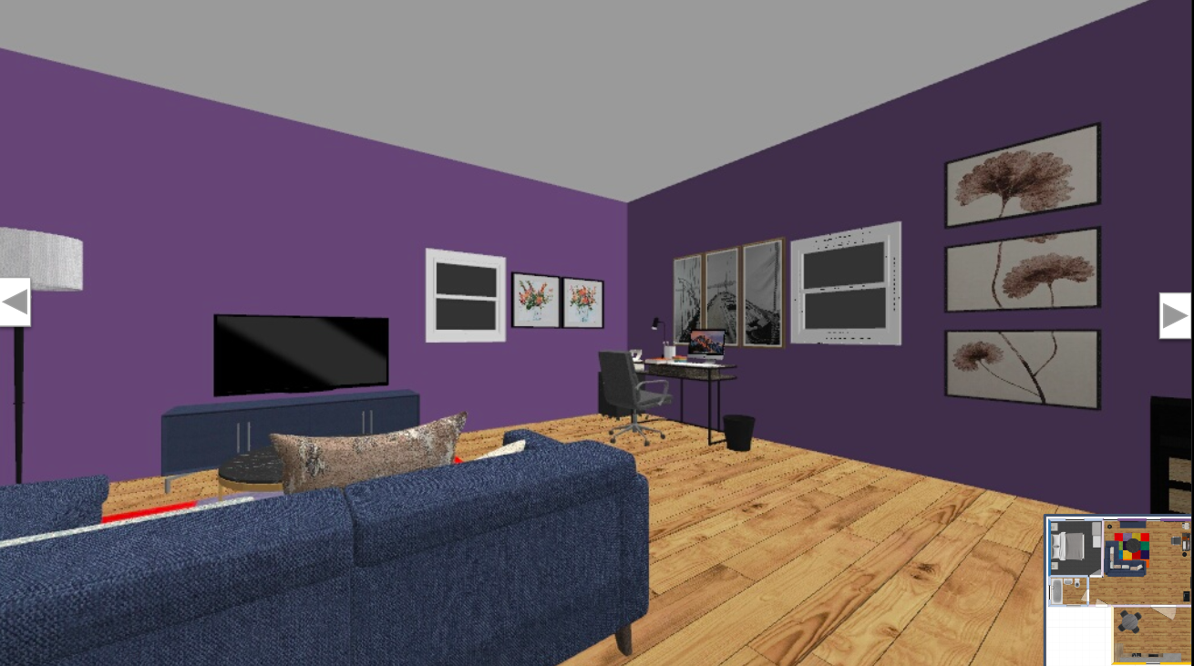
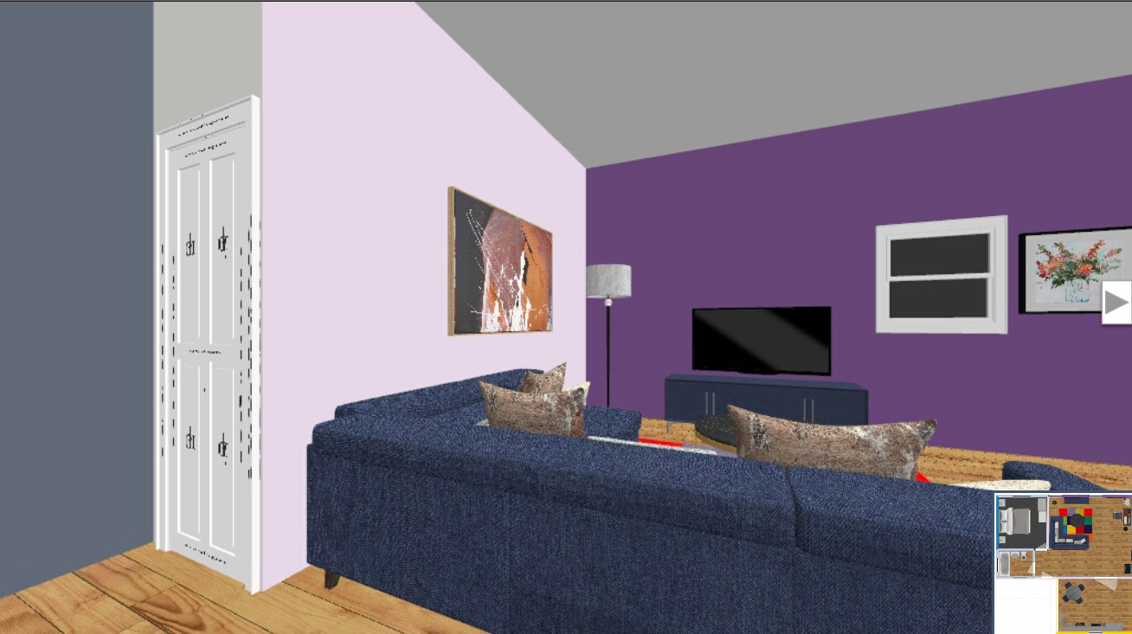
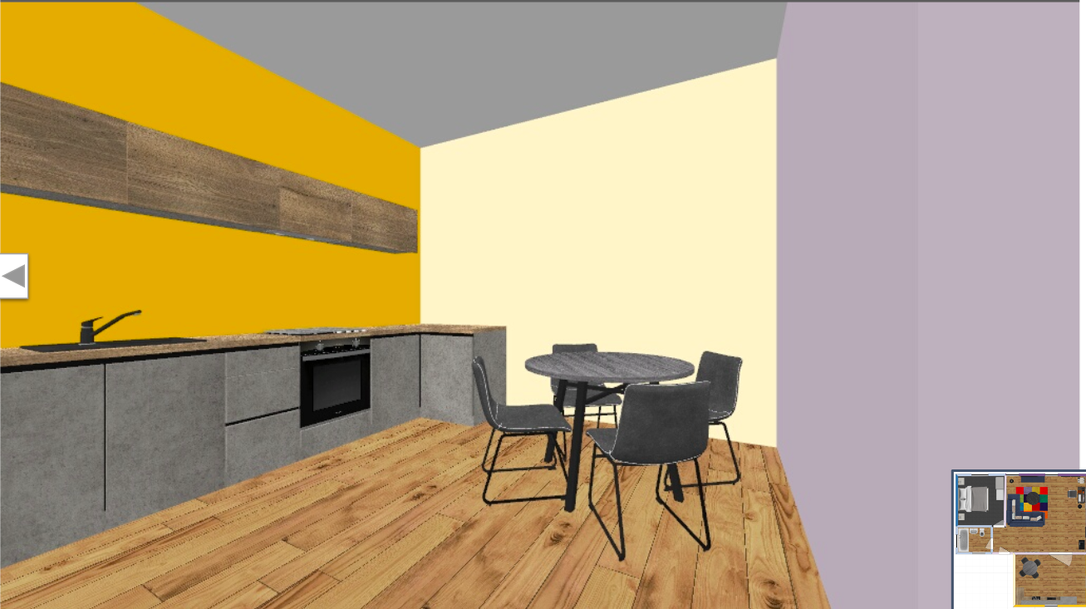

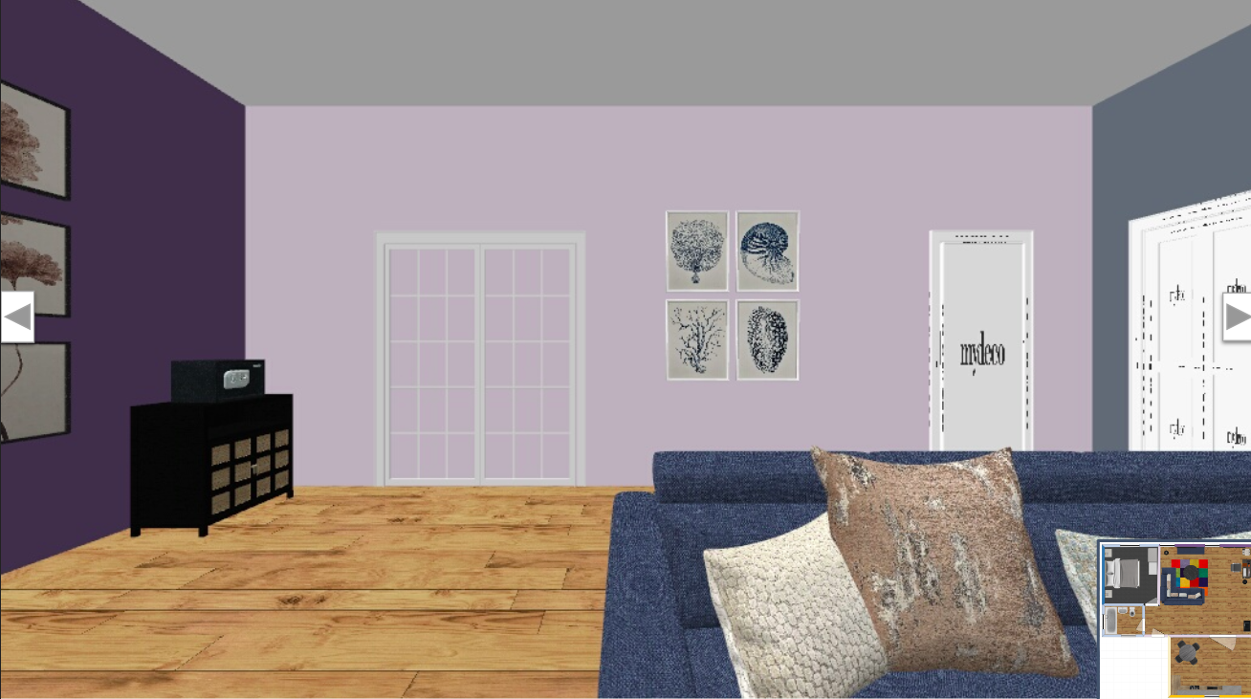
Tenth Paragraph:
Describe how you searched the suspect’s house.
What evidence did you find in the house and how does this show that the suspect is linked with the disappearance of Maria Burton?

Slide 11
Closing Paragraph:
Give a final closing speech as to why the evidence strongly suggest that the suspect has committed the offence.

